Slide 1
DevOps
Workshop I

Slide 2
About this workshop
This workshop provides the information you need to understand what “DevOps” means and how it is going to change the way business are made. You will understand why is difficult to tag DevOps as a methodology or culture or as a tag for tools or people.
This workshop focuses on the Three Ways introduced by Kevin Behr, George Spafford, Gene Kim at the book “The Phoenix Project: A novel about IT, DevOps and helping your business win”.

Slide 3
Goals
These are the main goals to reach for this workshop:
Introduce to the concept of “DevOps”
What is the goal of DevOps culture in the organization
How to build a DevOps team
What are the more usual DevOps tools
How to build a toolset for your purposes

Slide 4
Workshop Modules
Theory
Practice
Introduction
Lab Introduction
First Way
Create a CI & CD toolchain
Second Way
Create a KPI dashboard
Third Way
Culture of learning lab
Study Case

Slide 5
Workshop Plan
How this workshop is planned:
First session will cover the most theoretical part plus some technical concepts needed for the rest of the workshop like virtualization and cloud, programming, and some Agile concepts are needed.
We will see the Three Ways model of doing DevOps at the organization.
Then we will go to the First Way and try some new technologies.

Slide 6
Workshop
Second session: We will cover the Second Way and learn how communication is critical for a successful implementation of DevOps culture.
We will talk about establishing metrics to measure the success of our actions, from technical KPIs to business goals and OKR’s
We will be using external services to monitor and extract key quality indicators useful to define next goals
We will cover the Third Way and learn about how important is to do small steps and keep the flow constant. With our new skills, we should find bottlenecks and exploit them.

Slide 7
Workshop
Third session: we will be working on a Case of Studio using several tools in order to build a devops toolchain and deploys to different environments including production.
We will measure how are we improving our processes and set the basis for a think tank team that can be able to challenge future issues.
Of course, this session will be a very technical session, so high participation is welcomed.

Slide 8
Topics not covered
The workshop is limited in resources, so we cannot stop to talk about:
Basic programming concepts
Basic agile methodologies concepts
Basic Unix/Linux concepts
Basic web infrastructure concepts

Slide 9
Requirements
DevOps uses several tools and skills, so it’s not easy to cope with all of them. You will need:
Laptop with linux (preferably ubuntu, but any other is okay)
Connectivity: we will be connecting to external resources all the time

Slide 10
Components of each session
Goals: The main goals you should be able to accomplish after finishing the workshop.
Objectives: Modules objectives after finishing one.
Additional resources: bibliography and other links.
Lecture: The theoretical part.
Activities: The practical part.

Slide 11
Module 1
Objectives
What is the goal?
Describe the challenges of the business
Describe the problems
Describe the Agile Methodology benefits
Describe the Devops Way: the Three Ways
Introducing DevOps concepts and culture
Notes:
Devops 2014 sudamerica: http://www.slideshare.net/Tallerws/devops-por-donde-comenzar-drupalcon-latin-america-2015-44844606
Amazon AWS Devops: http://www.slideshare.net/AmazonWebServicesLATAM/2016-aws-summit-bogot-devops-en-aws
Devops PatKua: http://www.slideshare.net/thekua/devops-from-the-ground-up

Slide 12
Challenges and Goals
The Goal
“To make money” -- Eliyahu M. Goldratt
The Challenges
Organization must be competitive
Time-to-market is critical
High quality now
Cost reduction
Minimize risks

Slide 13
Development and Operations Foodfight
Development traditionally works with poor defined specifications, short times and high pressure.
Development push code to production. Code has bugs. So, Development push bugs to production.
Development don’t have enough time to make good (test, documentation, etc.)
Development don’t know about production issues.
Development don’t have a production environment to test

Slide 14
Development and Operations Foodfight
Operations keep production alive. Operations defend production. Operations investigate and circumvent issues.
Operations is the unexpected. Internal or external incidents affects production.
Operations are detectives. They must determine the causes and the “modus operandi” report it, and if possible, solve it.
Operations work is like firefighting.

Slide 15
Development and Operations Foodfight
Dev… Ops, but what about QA (Quality Assurance)?
Ha, ha!, poor boys…
They are developers that must find bugs in code made by others, but:
Where are the feature specifications? Where are the acceptance tests?
Development ships code too late for them to test
Who established a bug as CRITICAL?
QA is overpassed by business managers

Slide 16
Development and Operations Foodfight
Security and Network teams are operations teams that allows data go through infrastructure without issues.
They protect production as well, from development and operations as well.
They are not involved directly in development, so nobody ask them about network ports, network traffic, encryption or security laws (like personal protection data, security audits, or access controls).

Slide 17
Development and Operations Foodfight
Product/Project Managers define the roadmap of the product and protect it from delays, cuts, extends and whatever other things that affect the product.
Managers have to cope with people complaining all the time, from top to bottom.
Managers want to overcome business constraints.
Managers work with people and bureaucracy, sometimes they wish to be technicians.

Slide 18
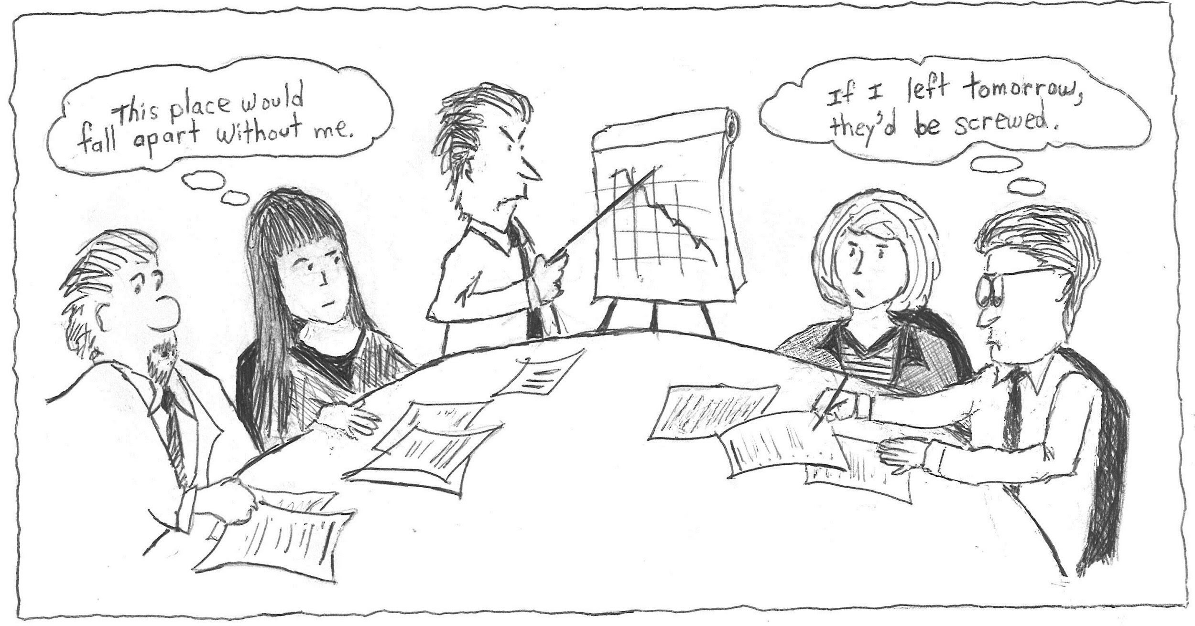
Business and IT Foodfight
Dysfunctional marriage between Business and IT
https://www.americanexpress.com/us/small-business/openforum/articles/7-signs-your-culture-is-dysfunctional/
Notes:
Mostrar esta página https://www.americanexpress.com/us/small-business/openforum/articles/7-signs-your-culture-is-dysfunctional/

Slide 19
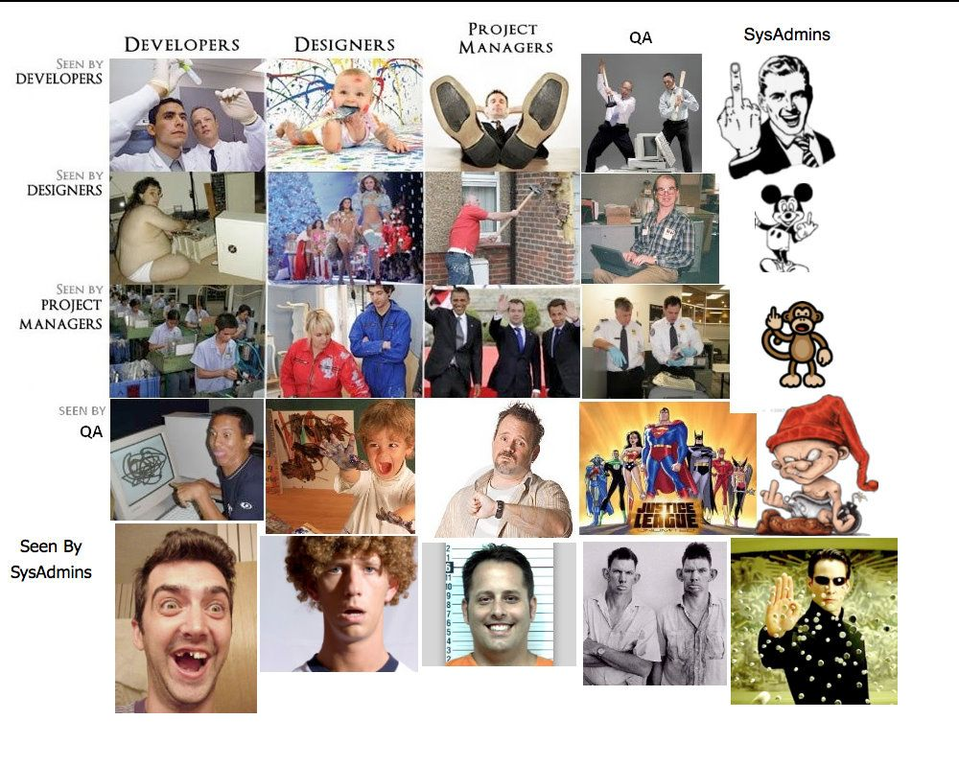
Pride, prejudices and businesses
This is your App Demo
How they are seen by
If your IT team has a problem, everybody at the business have a problem.

Slide 20
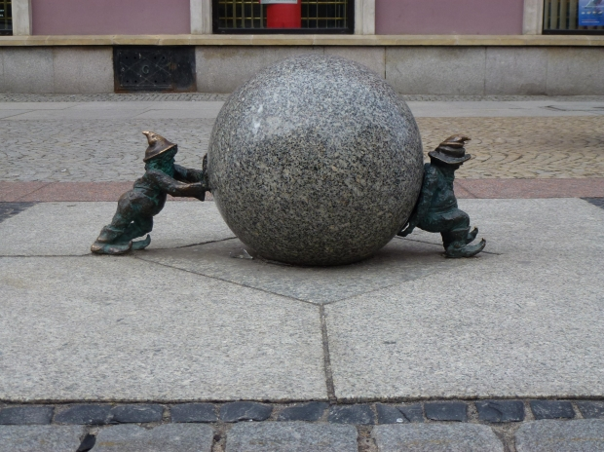
Devops
DevOps is a response to the growing awareness that there is a disconnect between what is traditionally considered development activity and what is traditionally considered operations activity.

Slide 21
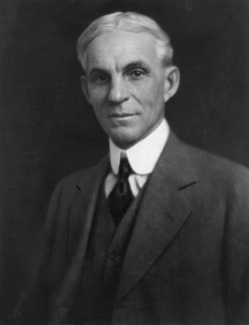
Coming together is a beginning,
Keeping together is progress,
Working together is success.
Henry Ford

Slide 22
DevOps
“DevOps [...] is a culture, movement or practice that emphasizes the collaboration and communication of both software developers and other information-technology (IT) professionals while automating the process of software delivery and infrastructure changes.^{[1][2]} It aims at establishing a culture and environment where building, testing, and releasing software can happen rapidly, frequently, and more reliably.^{[3][4][5]}” -- Wikipedia
Focus is on “Development AND Operations”, but all IT and Business are included in the culture and mindset of collaboration
References to "Agile Infrastructure" and “Agile Operations”
Notes:
Devops PatKua: http://www.slideshare.net/thekua/devops-from-the-ground-up
Term defined by Andrew Clay Shafer and Patrick Debois at the Agile 2008 conference

Slide 23
Devops
Agile Development together with Agile in Operations = Continuous Delivery
Small batches
Reduce risks
Pull the trigger
Keep the flow
Better audits
Development
Operations
Production

Slide 24


DevOps
Culture of change
Traditional datacenter - office Software defined infrastructure

Slide 25
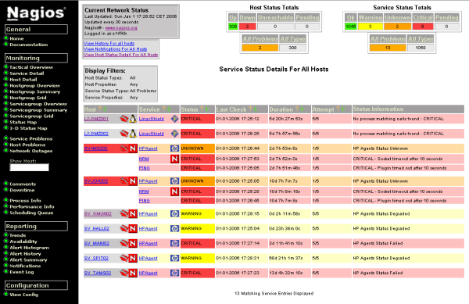
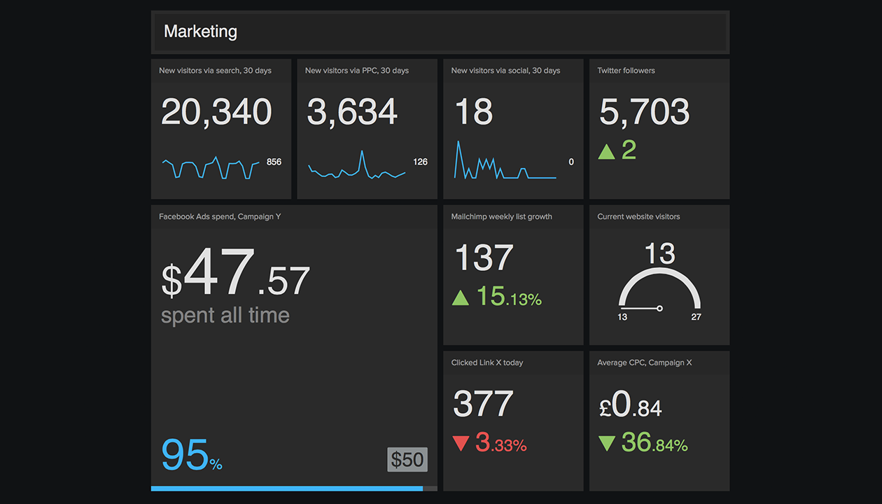
Devops
Culture of change
From system monitoring To business monitoring

Slide 26
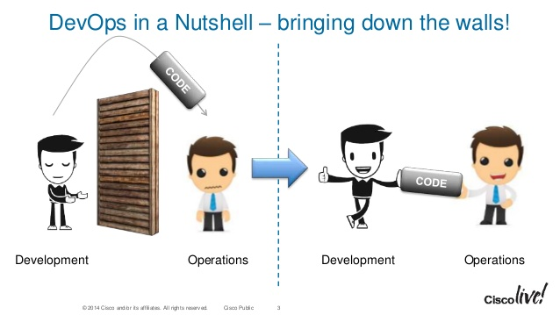
Devops
Communication as the way to work

Slide 27
Devops
People over processes over tools
People
Communication
Common goals
Shared responsability
Innovation
Cross-skills
No blame culture
Business - IT
Processes
Automation
Continuous Integration
Continuous Delivery
Continuous Monitoring
Infrastructure as Code
Configuration Management
Tools
Jenkins, Sonar, Nexus
Junit, Rspec, Cucumber
Vagrant, Cloudformation
Ansible, Puppet, Chef
NewRelic
Geckoboard
...
Notes:
https://www.americanexpress.com/us/small-business/openforum/articles/7-signs-your-culture-is-dysfunctional/

Slide 28

The Three Ways
To understand how DevOps works for your business
A guide to the IT revolution
Notes:
https://pixabay.com/en/gleise-old-railroad-tracks-seemed-1555348/

Slide 29
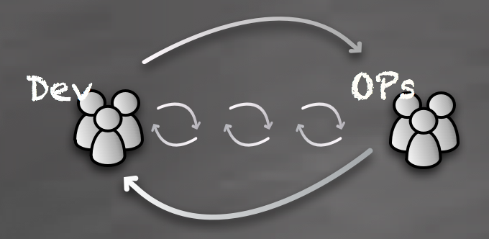
The Three Ways
A good way to understand what DevOps means to the business is by understanding the Three Ways defined in the book “The Phoenix project” by Gene Kim, Kevin Behr and George Spafford.
http://itrevolution.com/the-three-ways-principles-underpinning-devops/

Slide 30
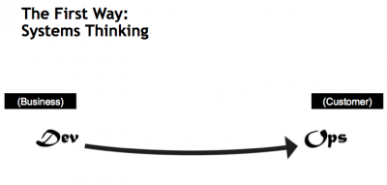
Emphasizes the performance of the entire system
The focus is: all business value streams are enabled by IT
Outcomes are:
don’t pass defects downstreams to work centers
focus on global optimization, not local optimizations

Slide 31
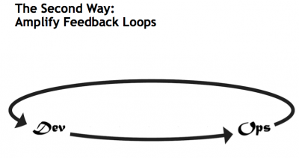
Emphasizes the feedback loops and the increasing speed of corrections
The focus is: valuable data comes from real world.
Outcomes are:
comprehension and responding to customers needs
amplify knowledge and impact with loops of feedback

Slide 32
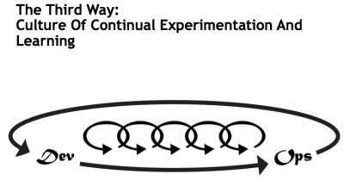
Emphasizes continual experimentation
repetition and practice is the prerequisite to mastery
The focus is: on learning and experimenting
Outcomes are:
travelling from survival phase to learning and self-organization phase
increase resilience of product

Slide 33
Commandments for a good Devops culture
If it's not monitorized, it's not in production.
Unplanned work steals time from planned work.
We're all in IT together.
Operational requirements are as important as functional requirements.
Ship it.
Call it DevOps, NoOps or Devs & Ops. It's about people.
We're all on pagerduty together.
Philosophy or framework; do what works and makes business efficient.
DevOps encompasses development, operations, management, admin staff, sales, cleaning, graphic designers, baristas and more.
Read "The Phoenix Project", "The Goal", "Critical Chain" and “The Devops Handbook”.
Get your boss to read "The Phoenix Project".
Process isn't a dirty word.
Integrate continuously, because anything can break.
Deploy continuously, because deployment is a core process and practice makes perfect.
Communicate continuously, because people are at the core of the process.
Identify your bottlenecks.
Automate everything... unless you're a nuclear plant.
Automate everything anyway!
How they are seen by
http://madrid.devops.es/

Slide 34
Summary Module 1
Do we have a good understanding about?
Challenges of the business
The problems to reach the Goal
Agile Methodology benefits
The Devops Way: the Three Ways
Introduce to DevOps concepts and culture

Slide 35
Lab 1
Objectives:
We are going to discuss experiences about previous jobs and projects where this perspective would help to success.
Estimated time: 1 hour

Slide 36
Lab 1
Describe your last project. Introduce your role in the team. Describe how the deployment process was and what problems raised on production.
Use the retrospective strategy:
What did work?
What didn’t work?
How we could change bad things using the Three Ways

